Slide 1
Complex Variable, Laplace & Z- transformation
Lecture 05

Slide 2
This Lecture Covers-
1. Inverse Laplace transformation using partial fraction with type unrepeated, repeated and complex or irrational factors.
2. Inverse Laplace transformation associated with unit step function.

Slide 3
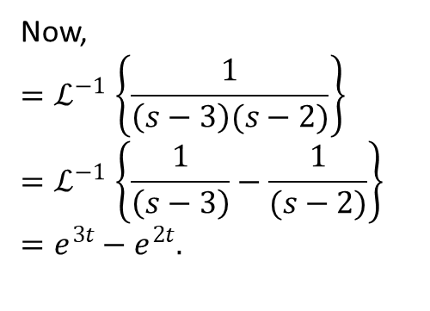
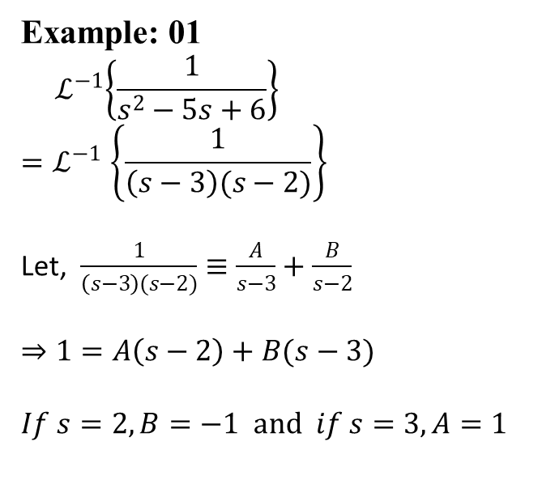
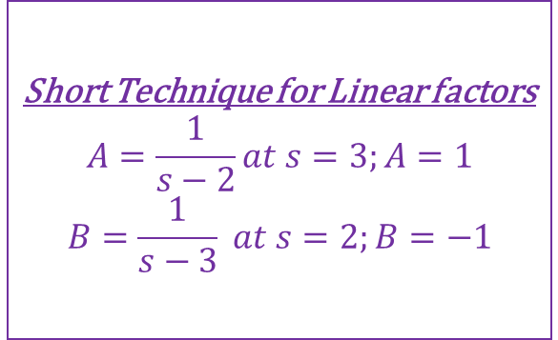
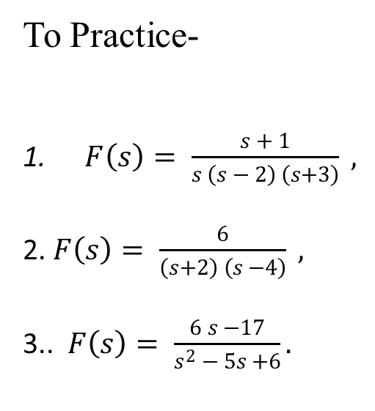
Inverse Laplace Transformation Using Partial Fraction
Example on type Unrepeated Factors (Linear Factors)
Example: 01
$${ ℒ}^{−1}\left\{\frac{1}{s^{2}−5s+6}\right\}$$
$${=ℒ}^{−1}\left\{\frac{1}{\left(s−3\right)(s−2)}\right\}$$
Let, $\frac{1}{\left(s−3\right)(s−2)}≡\frac{A}{s−3}+\frac{B}{s−2}$
$$⇒1=A\left(s−2\right)+B(s−3)$$
$$If s=2, B=−1 and if s=3, A=1$$
Now,
$${=ℒ}^{−1}\left\{\frac{1}{\left(s−3\right)(s−2)}\right\}$$
$${=ℒ}^{−1}\left\{\frac{1}{\left(s−3\right)}−\frac{1}{(s−2)}\right\}$$
$$=e^{3t}−e^{2t}.$$
To Practice-
$F\left(s\right)= \frac{s + 1}{s \left(s − 2\right) \left(s+3\right)} ,$
2. $F\left(s\right)= \frac{6}{\left(s+2\right) \left(s −4\right)} ,$
3.. $F\left(s\right)= \frac{6 s −17}{s^{2} − 5s +6}.$
Short Technique for Linear factors
$$A=\frac{1}{s−2}at s=3;A=1$$
$$B=\frac{1}{s−3} at s=2;B=−1$$

Slide 4
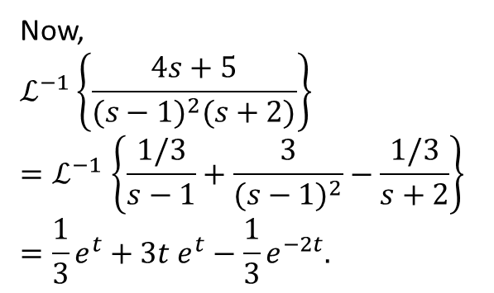
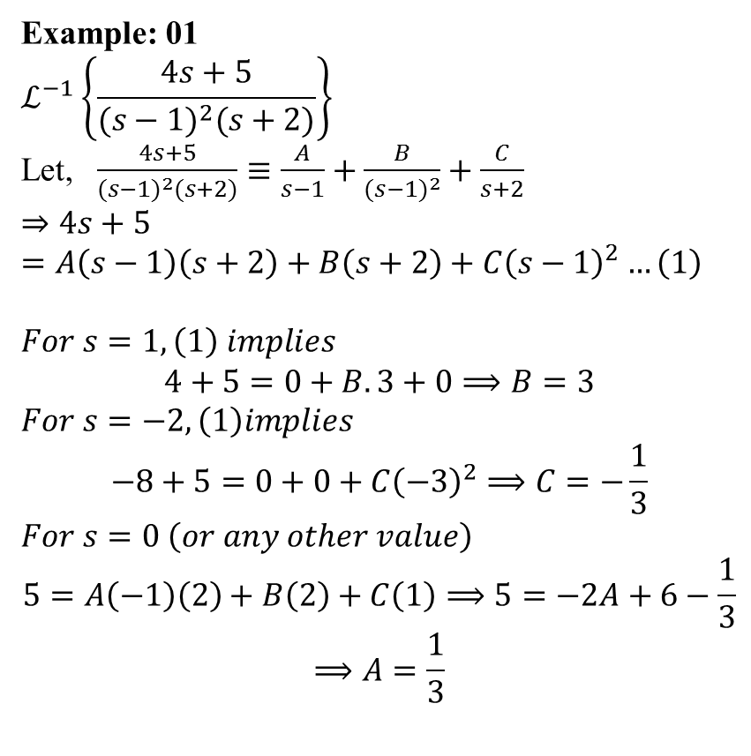
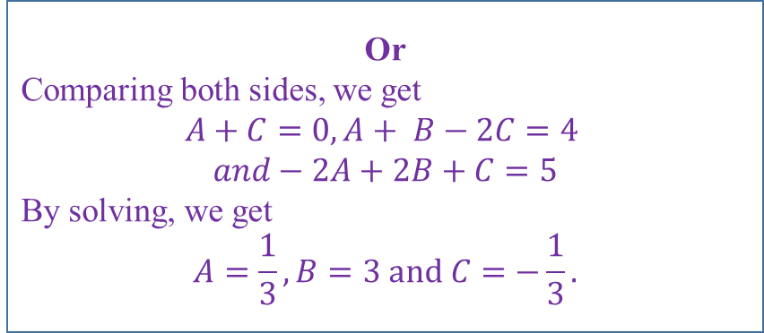
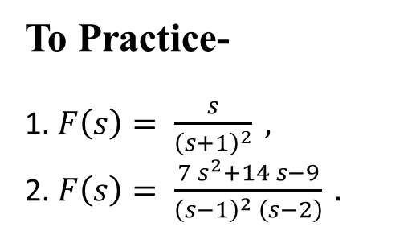
Inverse Laplace Transformation Using Partial Fraction
Example on type Repeated Factors
Example: 01
$$ℒ^{−1}\left\{\frac{4s+5}{(s−{1)}^{2}(s+2)}\right\}$$
Let, $\frac{4s+5}{(s−{1)}^{2}(s+2)}≡\frac{A}{s−1}+\frac{B}{{(s−1)}^{2}}+\frac{C}{s+2}$
$$⇒4s+5=A\left(s−1\right)\left(s+2\right)+B\left(s+2\right)+C{\left(s−1\right)}^{2}…\left(1\right)$$
$$For s=1, \left(1\right) implies$$
$$4+5=0+B.3+0⟹B=3$$
$$For s=−2, \left(1\right)implies$$
$$−8+5=0+0+C{\left(−3\right)}^{2}⟹C=−\frac{1}{3}$$
$$For s=0 \left(or any other value\right)$$
$$5=A\left(−1\right)\left(2\right)+B\left(2\right)+C\left(1\right)⟹5=−2A+6−\frac{1}{3}$$
$$⟹A=\frac{1}{3}$$
Now,
$$ℒ^{−1}\left\{\frac{4s+5}{(s−{1)}^{2}(s+2)}\right\}$$
$${=ℒ}^{−1}\left\{\frac{1/3}{s−1}+\frac{3}{{(s−1)}^{2}}−\frac{1/3}{s+2}\right\}$$
$$=\frac{1}{3}e^{t}+3t e^{t}−\frac{1}{3}e^{−2t}.$$
To Practice-
1. $F\left(s\right)= \frac{s}{{\left(s+1\right)}^{2}} ,$
2. $F\left(s\right)= \frac{7 s^{2}+14 s−9}{{\left(s−1\right)}^{2} \left(s−2\right)} .$
Or
Comparing both sides, we get
$$A+C=0,A+ B−2C=4$$
$$and−2A+2B+C=5$$
By solving, we get
$$A=\frac{1}{3},B=3 and C=−\frac{1}{3}.$$

Slide 5
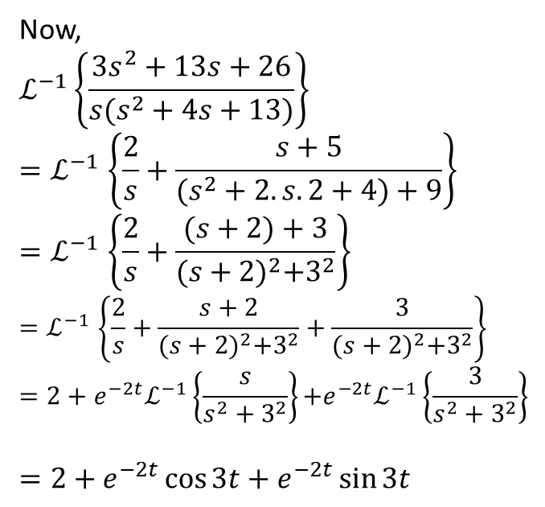
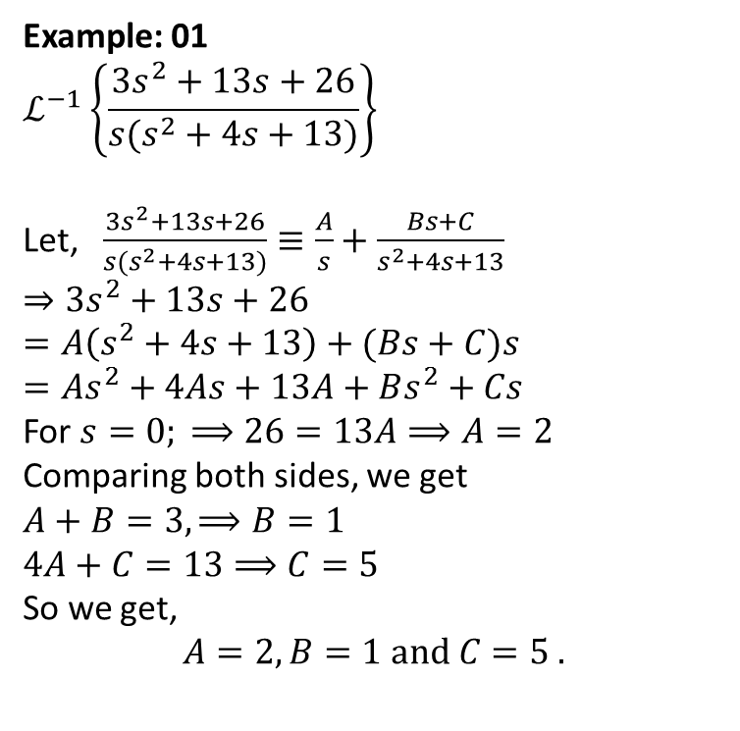
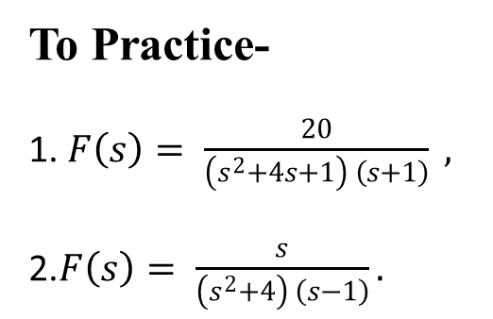
Inverse Laplace Transformation Using Partial Fraction
Example on type Factors with Complex or Irrational Roots
Example: 01
$$ℒ^{−1}\left\{\frac{3s^{2}+13s+26}{{s(s}^{2}+4s+13)}\right\}$$
Let, $\frac{3s^{2}+13s+26}{{s(s}^{2}+4s+13)}≡\frac{A}{s}+\frac{Bs+C}{s^{2}+4s+13}$
$$⇒3s^{2}+13s+26=A\left(s^{2}+4s+13\right)+(Bs+C)s$$
$$=As^{2}+4As+13A+Bs^{2}+Cs$$
For $s=0; ⟹26=13A⟹A=2$
Comparing both sides, we get
$$A+B=3, ⟹B=1$$
$$4A+C=13⟹C=5$$
So we get,
$$A=2, B=1 and C=5 .$$
Now,
$$ℒ^{−1}\left\{\frac{3s^{2}+13s+26}{{s(s}^{2}+4s+13)}\right\}$$
$${=ℒ}^{−1}\left\{\frac{2}{s}+\frac{s+5}{(s^{2}+2.s.2+4)+9}\right\}$$
$${=ℒ}^{−1}\left\{\frac{2}{s}+\frac{(s+2)+3}{{(s+2)}^{2}+3^{2}}\right\}$$
$${=ℒ}^{−1}\left\{\frac{2}{s}+\frac{s+2}{{(s+2)}^{2}+3^{2}}+\frac{3}{{(s+2)}^{2}+3^{2}}\right\}$$
$$=2+{e^{−2t}ℒ}^{−1}\left\{\frac{s}{s^{2}+3^{2}}\right\}{{+e}^{−2t}ℒ}^{−1}\left\{\frac{3}{s^{2}+3^{2}}\right\}$$
$$=2+e^{−2t}\cos{3t}+e^{−2t}\sin{3t}$$
To Practice-
1. $F\left(s\right)= \frac{20}{\left(s^{2}+4s+1\right) \left(s+1\right)} ,$
2.$F\left(s\right)= \frac{s}{\left(s^{2}+4\right) \left(s−1\right)}.$

Slide 6
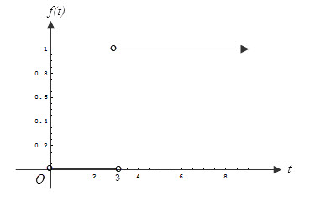
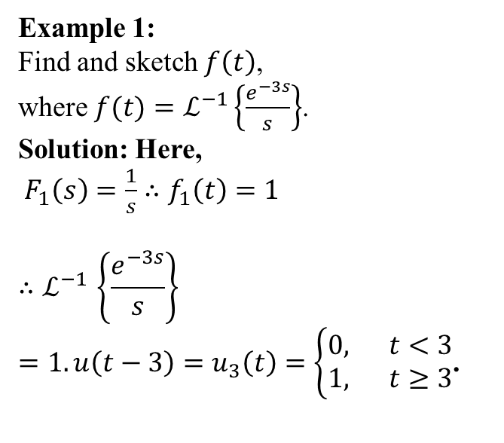
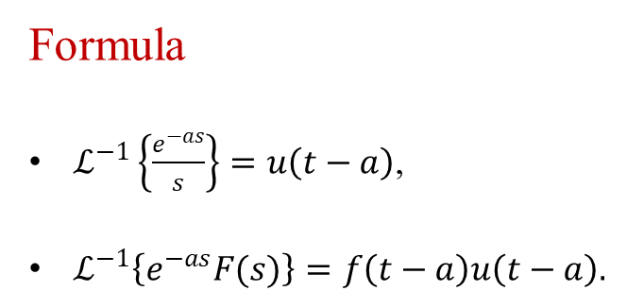
Inverse Laplace Transformation Associated with Unit Step Function
Formula
$ℒ^{−1}\left\{\frac{e^{−as}}{s}\right\}=u\left(t−a\right)$,
$ℒ^{−1}\left\{e^{−as}F(s)\right\}=$ $f\left(t−a\right)u\left(t−a\right).$
Example 1:
Find and sketch $f\left(t\right)$, where $f(t)=ℒ^{−1}\left\{\frac{e^{−3s}}{s}\right\}$.
Solution: Here,
${ F}_{1}\left(s\right)=\frac{1}{s}$ $∴f_{1}\left(t\right)=1$
$${∴ℒ}^{−1}\left\{\frac{e^{−3s}}{s}\right\}$$
$=1.u\left(t−3\right)=u_{3}\left(t\right)=\left\{\begin{aligned}0, t<3 \\ 1, t≥3\end{aligned}\right.$.

Slide 7
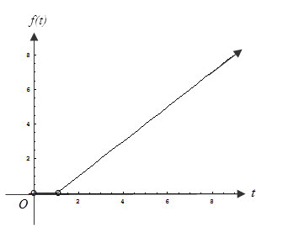
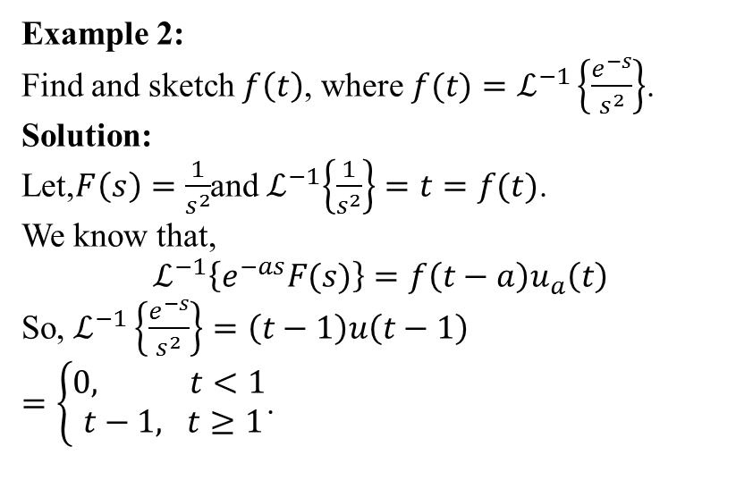
Inverse Laplace Transformation Associated with Unit Step Function
Example 2:
Find and sketch $f\left(t\right)$, where $f(t)=ℒ^{−1}\left\{\frac{e^{−s}}{s^{2}}\right\}$.
Solution:
Let,$F\left(s\right)=\frac{1}{s^{2}}$and${ ℒ}^{−1}\left\{\frac{1}{s^{2}}\right\}=t=f(t)$.
We know that,
$$ℒ^{−1}\left\{e^{−as}F(s)\right\}=f\left(t−a\right)u_{a}\left(t\right)$$
So, $ℒ^{−1}\left\{\frac{e^{−s}}{s^{2}}\right\}=\left(t−1\right)u\left(t−1\right)$
$=\left\{\begin{aligned}0, t<1 \\ t−1, t≥1\end{aligned}\right.$.

Slide 8
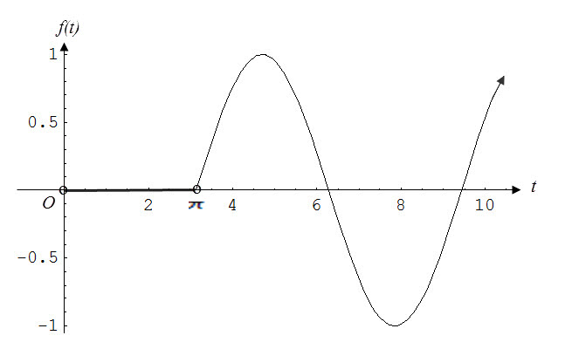
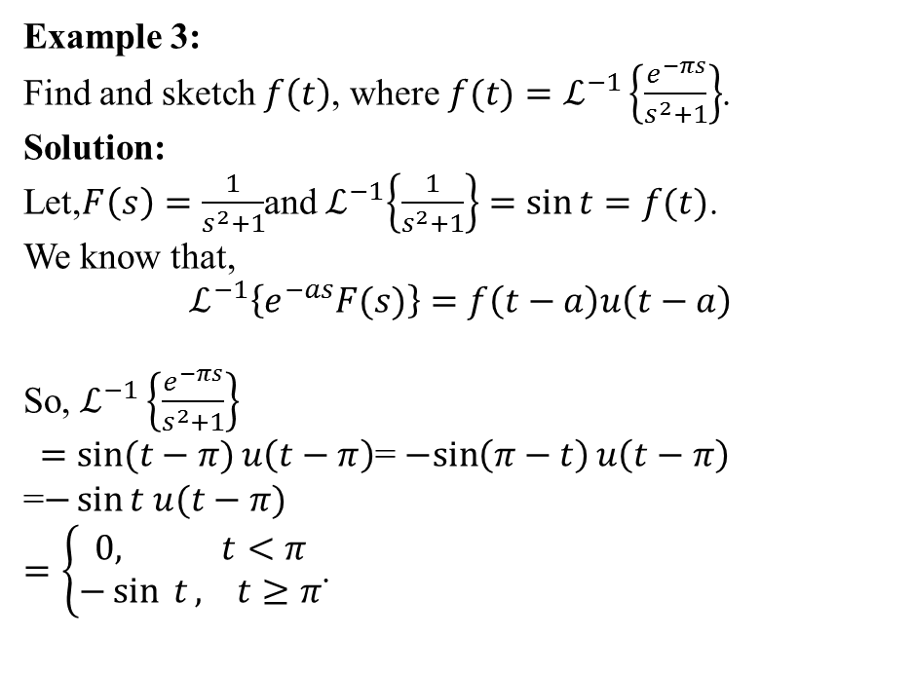
Inverse Laplace Transformation Associated with Unit Step Function
Example 3:
Find and sketch $f\left(t\right)$, where $f(t)=ℒ^{−1}\left\{\frac{e^{−πs}}{s^{2}+1}\right\}$.
Solution:
Let,$F\left(s\right)=\frac{1}{s^{2}+1}$and${ ℒ}^{−1}\left\{\frac{1}{s^{2}+1}\right\}=\sin{t}=f(t)$.
We know that,
$$ℒ^{−1}\left\{e^{−as}F(s)\right\}=f\left(t−a\right)u\left(t−a\right)$$
So, $ℒ^{−1}\left\{\frac{e^{−πs}}{s^{2}+1}\right\}$
$=\sin{(t−π)}u\left(t−π\right)$= $−sin\left(π−t\right)u\left(t−π\right)$
=$−\sin{t u(t−π)}$
$=\left\{\begin{aligned}0, t<π \\ −\sin{ t}, t≥π\end{aligned}\right.$.

Slide 9
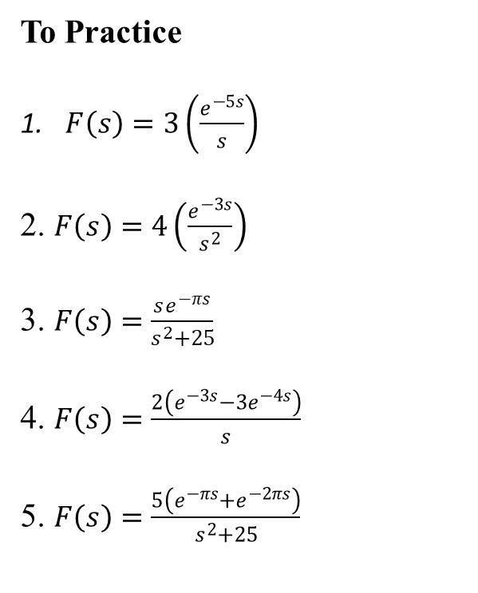
Inverse Laplace Transformation Associated with Unit Step Function
To Practice
$F\left(s\right)=3\left(\frac{e^{−5s}}{s}\right)$
2. $F\left(s\right)=4\left(\frac{e^{−3s}}{s^{2}}\right)$
3. $F\left(s\right)=\frac{se^{−πs}}{s^{2}+25}$
4. $F\left(s\right)=\frac{2\left(e^{−3s}−3e^{−4s}\right)}{s}$
5. $F\left(s\right)=\frac{5\left(e^{−πs}+e^{−2πs}\right)}{s^{2}+25}$

Slide 10
Learning Outcomes
After completing this lecture you will know how to evaluate inverse Laplace transformation using partial fraction and also inverse Laplace transformation associated with unit step function.

Slide 11












Sample MCQ
1. $ℒ^{−1}\left\{\frac{6}{\left(s+2\right) \left(s −4\right)}\right\}=?$
(a) $e^{t}−e^{−2t}$
(b) $e^{4t}−e^{−2t}$
(c) $e^{4t}−e^{2t}$
(d)${ e}^{3t}−e^{−2t}$
2. $ℒ^{−1}\left\{\frac{s}{{\left(s+1\right)}^{2}}\right\}=?$
(a)${ e}^{−t}−t e^{−t}$
(b)${ e}^{t}−t e^{−t}$
(c)${ e}^{−t}−e^{−t}$
(d)${ e}^{−t}−t e^{t}$
3. $ℒ^{−1}\left\{\frac{s}{\left(s^{2}+4\right) \left(s−1\right)}\right\}=?$
(a)$\frac{2}{5}\sin{2t− \frac{1}{5}\cos{2t}+\frac{1}{5} e^{t}}$
(b)$\frac{2}{3}\sin{2t− \frac{1}{5}\cos{2t}+\frac{1}{5} e^{t}}$
(c)$\sin{2t− \frac{1}{5}\cos{2t}+\frac{1}{5} e^{t}}$
(d)$\frac{2}{5}\sin{2t+ \frac{1}{5}\cos{2t}+\frac{1}{5} e^{t}}$

